Slide 1

Group 11
Level 4/5 Group 11
Razvan Muresan
Tyler Martignetti
Joseph Shuttlewood
John Rance
razvan muresan
joseph shuttlewood
tyler martignetti
john rance

Slide 2
DEMO

Slide 3
Key features
2 PLAYER GAME
24 PLAYABLE LEVELS
Multiple difficulty settings
Beautifully designed and balanced levels

Slide 4
What players enjoy
Iterations made on the levels to promote people fun
Level erosion for adversarial gameplay
Competition

Slide 5

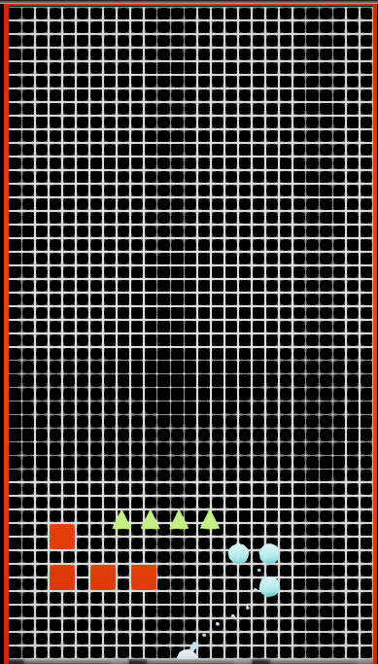
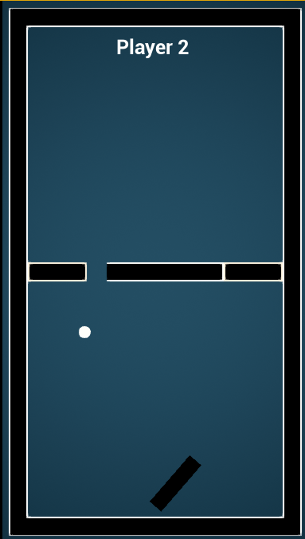
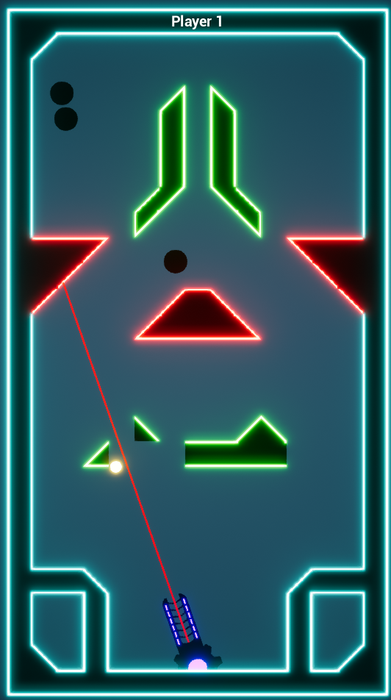
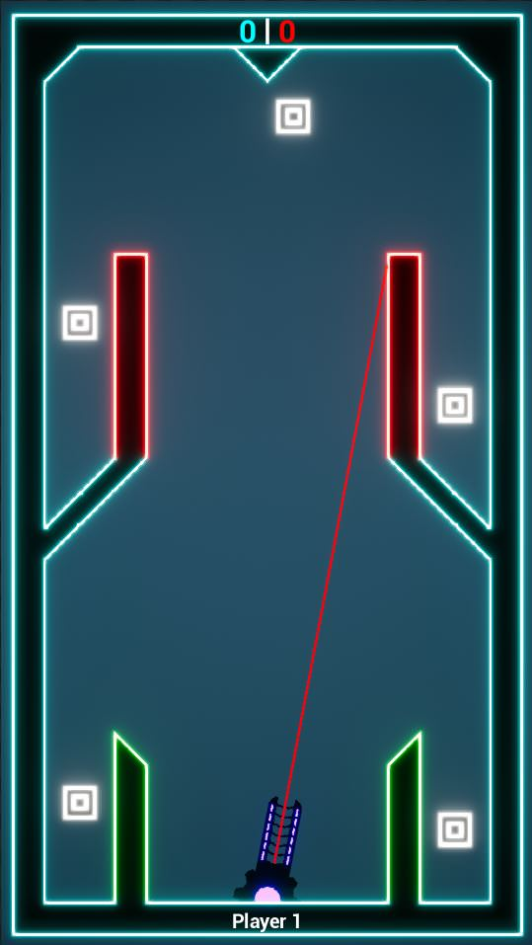
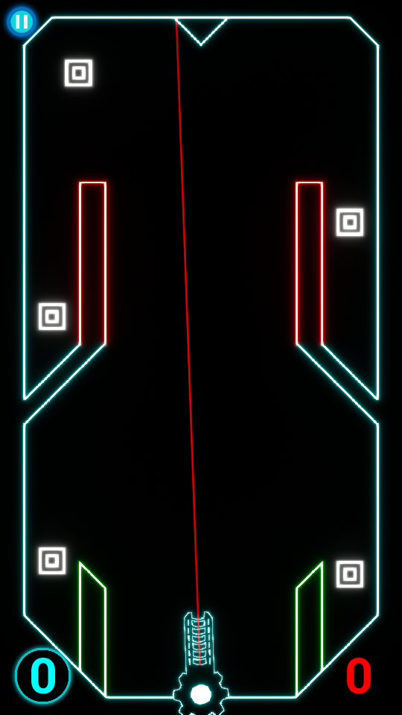
Our Game & iterations
16th February
21st February
26th February
5th March
Today

Slide 6
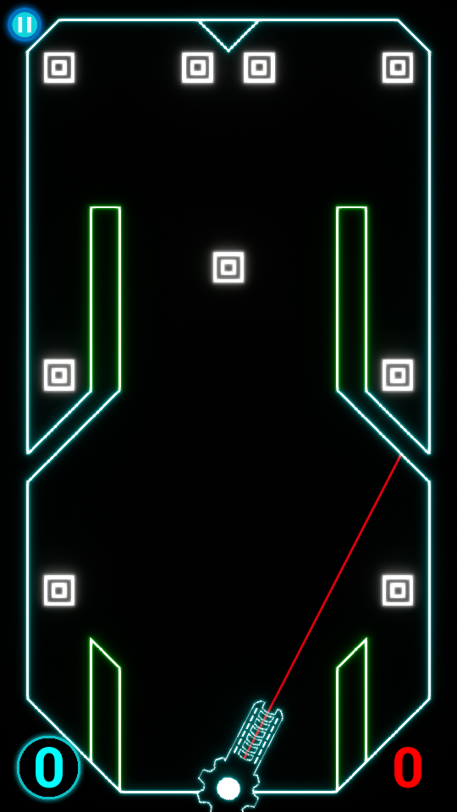
Finding the best solution

Slide 7
Critical changes
Most moving targets were removed
A lot of the very punishing red blocks were turned into green blocks
Most triangle blocks were removed

Slide 8
Major changes from feedback
Hardware button functionality was implemented
Game window and UI elements scaled to display properly
3 Tutorial levels added to introduce mechanics

Slide 9
Removing the challenge
Changed the levels drastically to help with triggering the emotions we were aiming for
Added our previous levels to a toggle-able ‘Hard Mode’
Harder levels consist of more moving parts, fewer targets, more red blocks

Slide 10
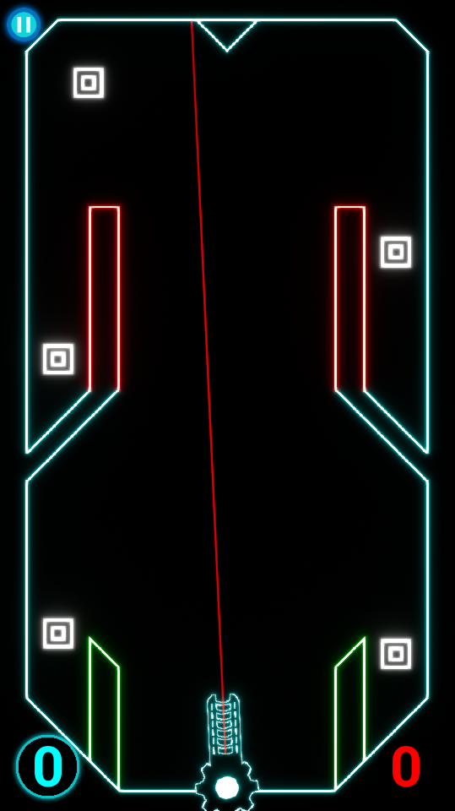
Normal levels vs hard mode

Slide 11
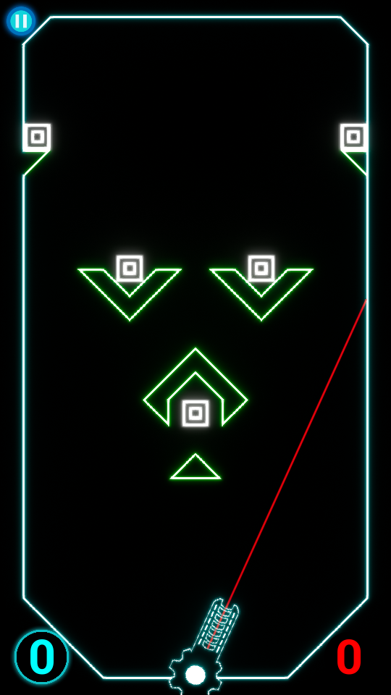
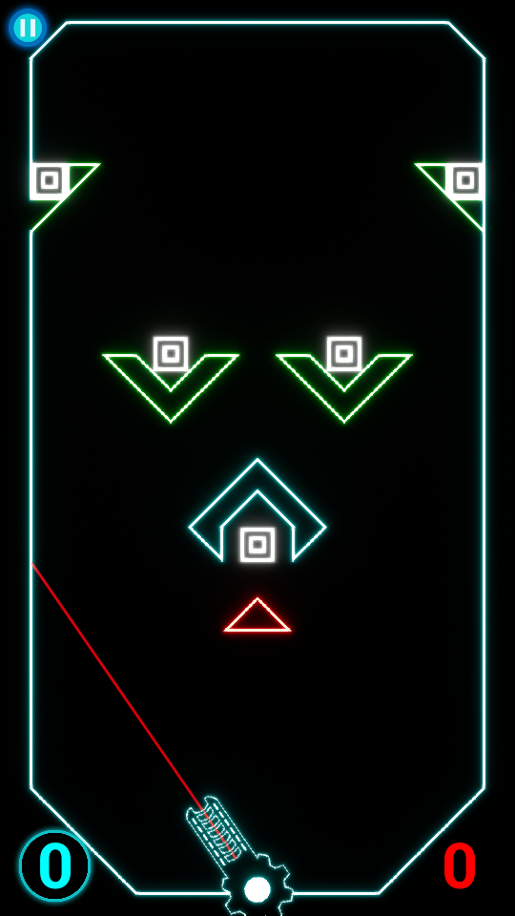
Normal levels vs hard mode

Slide 12
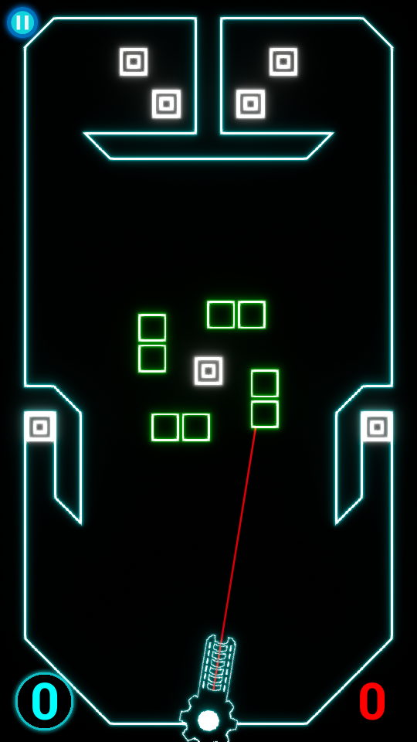
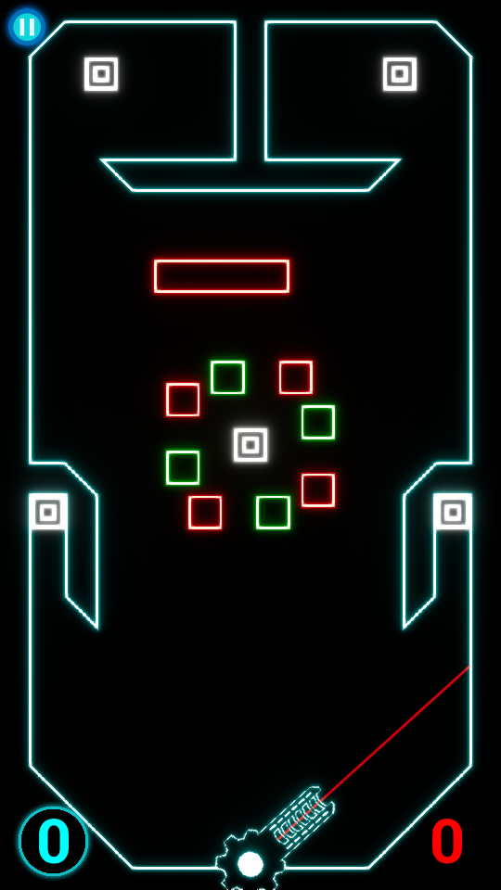
Normal levels vs hard mode

Slide 13
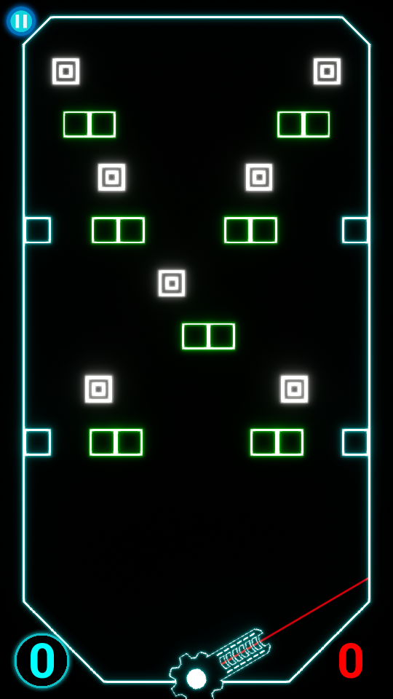
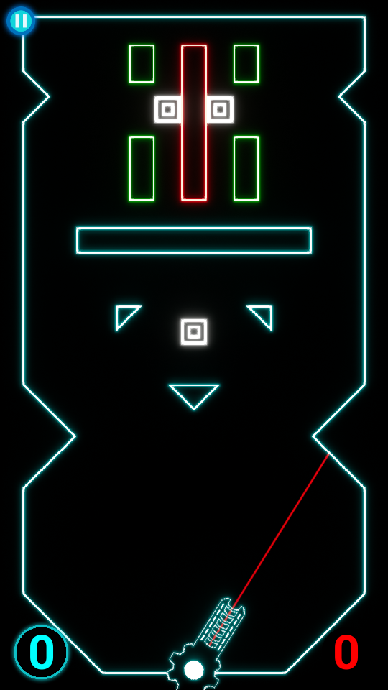
Normal levels vs hard mode

Slide 14
Key Design lessons
Difficulty – The game does not need to be challenging to be fun
Pin pointing the unwanted emotions people experience

Slide 15
Key programming lessons
Persistence – Saving settings and progress between play sessions
Source control – Figured out how to collaborate on the project more effectively and cleanly without interfering with other people’s work
Particle effects engine – Learned how to create partciles that communicate feedback to the player effectively
Material engine – Learned the fundamentals of the material editor and using emissive textures

Slide 16
Key management lessons
Effective and constant communication is good
Meetings in person can help with resolving any differences

Slide 17
Questions

